Slide 1

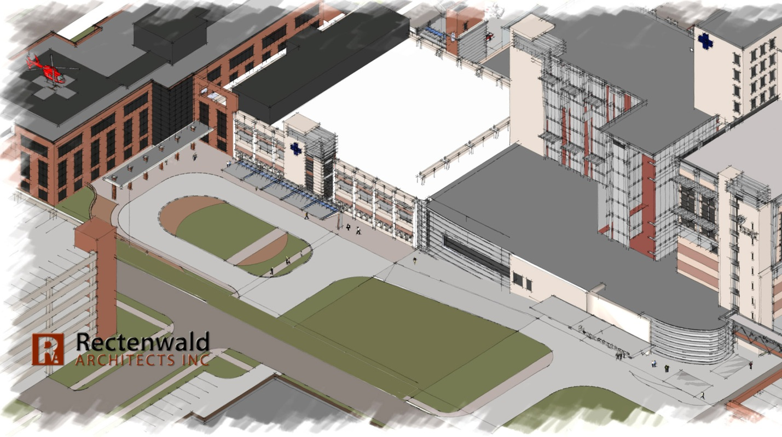



Saint Vincent Health Center
New Addition Project
Erie, PA
PENN STATE AE SENIOR CAPSTONE PROJECT
Tyler Jaggi | CONSTRUCTION MANAGEMENT
DR. David Riley - CM ADVISOR

Slide 2
Saint Vincent Health Center
New Addition Project
Erie, PA
PENN STATE AE SENIOR CAPSTONE PROJECT
Tyler Jaggi | CONSTRUCTION MANAGEMENT
DR. David Riley - CM ADVISOR
PRESENTATION OUTLINE:
  PROJECT BACKGROUND
  ANALYSIS #1: Re-Sequencing Phasing
    Background
    Case Findings
    Recommendations
  ANALYSIS #2: Precast Façade
    Design
    Structural Impact
    Schedule/Cost Impact
    Project Impact
    The Choice
  ANALYSIS #3: BIM Implementation
  ANALYSIS #4: ICRA Plan
    ICRA Matrix
    Areas of Risk
    Construction Precautions
    Mechanical Impact
  LESSONS LEARNED
  ACKNOWLEDGEMENTS

Slide 3
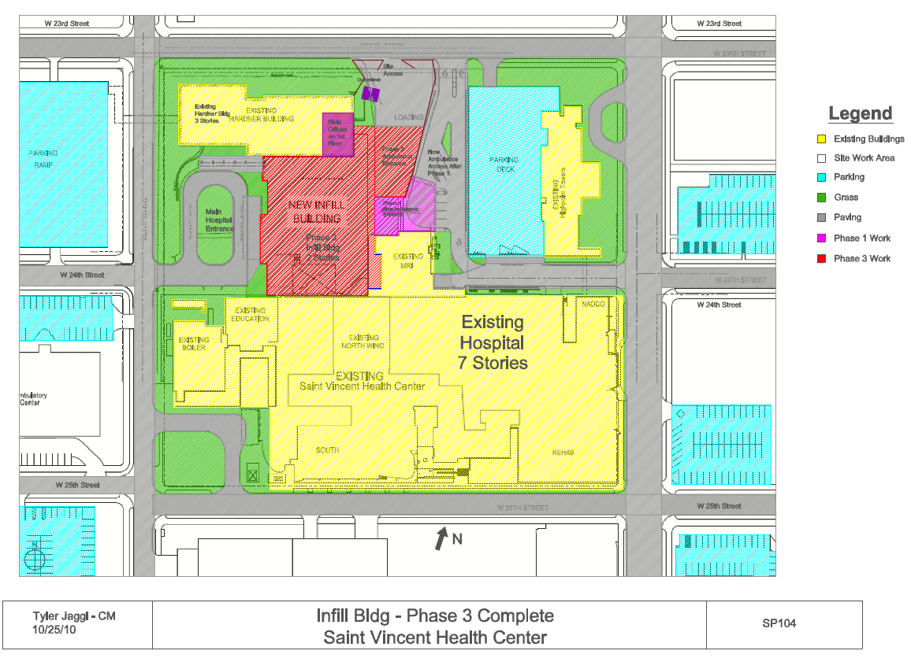
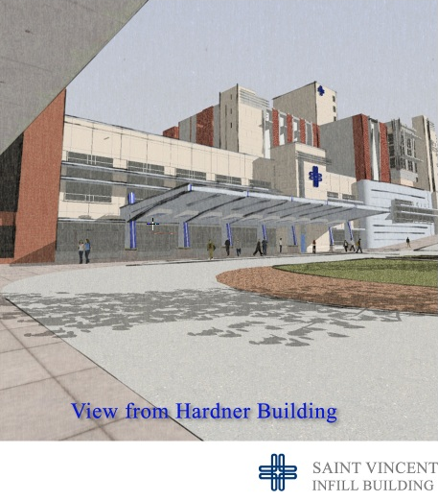
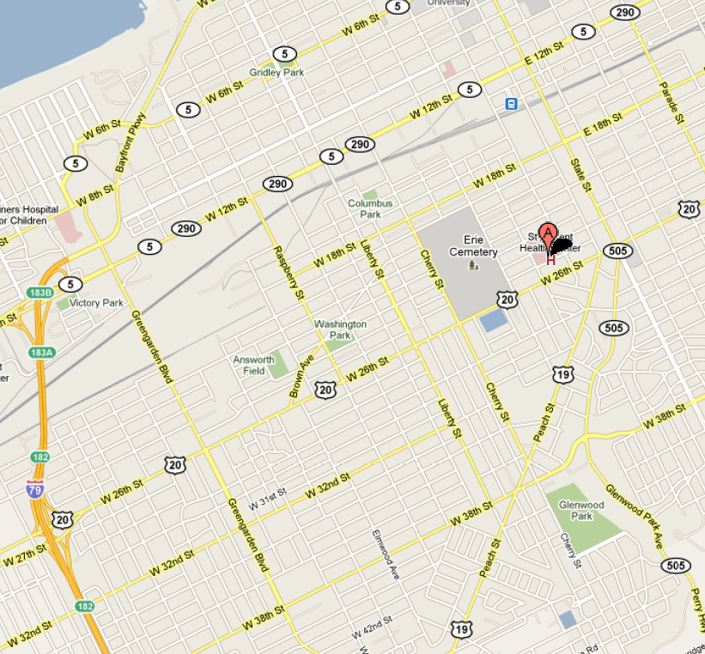


Saint Vincent Health Center
New Addition Building
Erie, PA
Tyler jaggi | CONSTRUCTION MANAGEMENT
PROJECT BACKGROUND
Saint Vincent Health Center
New Addition Building
Erie, PA
TYLER JAGGI | CONSTRUCTION MANAGEMENT
PRESENTATION OUTLINE:
  PROJECT BACKGROUND
  ANALYSIS #1: Re-Sequencing Phasing
    Background
    Case Findings
    Recommendations
  ANALYSIS #2: Precast Façade
    Design
    Structural Impact
    Schedule/Cost Impact
    Project Impact
    The Choice
  ANALYSIS #3: BIM Implementation
  ANALYSIS #4: ICRA Plan
    ICRA Matrix
    Areas of Risk
    Construction Precautions
    Mechanical Impact
  LESSONS LEARNED
  ACKNOWLEDGEMENTS
LOCATION:
  232 West 25th Street Erie, PA
  Private Health Center Complex– Saint Vincent
BUILDING PARAMATERS:
  104,660 SF gross building area
PROJECT PARAMETERS:
  Negotiated GMP: approx. $45 million
  Dates of Construction: 6/22/2010 – June 2012
  Delivery Method: Design-Build with CM
  LEED Certification: Silver
3

Slide 4
Saint Vincent Health Center
New Addition Building
Erie, PA
Tyler jaggi | CONSTRUCTION MANAGEMENT
PROJECT BACKGROUND
Saint Vincent Health Center
New Addition Building
Erie, PA
TYLER JAGGI | CONSTRUCTION MANAGEMENT
PRESENTATION OUTLINE:
  PROJECT BACKGROUND
  ANALYSIS #1: Re-Sequencing Phasing
    Background
    Case Findings
    Recommendations
  ANALYSIS #2: Precast Façade
    Design
    Structural Impact
    Schedule/Cost Impact
    Project Impact
    The Choice
  ANALYSIS #3: BIM Implementation
  ANALYSIS #4: ICRA Plan
    ICRA Matrix
    Areas of Risk
    Construction Precautions
    Mechanical Impact
  LESSONS LEARNED
  ACKNOWLEDGEMENTS
BUILDING”S PURPOSE:
  upgrade their Emergency Department and Operating Rooms
  In Basement - new Central MEP Plant will replace the entire MEP services for the entire complex of buildings
BUILDING PHASING:
  3 - Phase Project
    New Ambulance Entrance
    Creating new connecting Corridor / Demoing existing Connecting Corridor
    New In-Fill Building (main Part)
CODES:
  local: IBC by local jurisdiction (B.I.U.)
  Department: FGI Guidelines for design and Construction of Health Care
  State: NFPA by State Department of Health
4

Slide 5
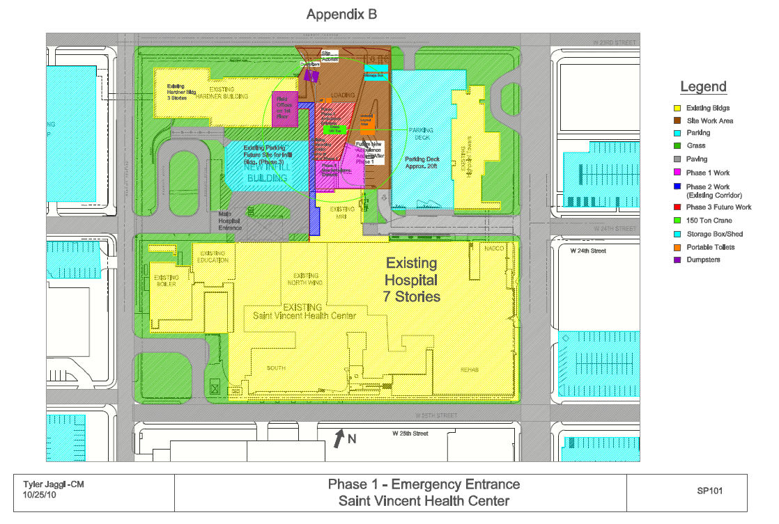
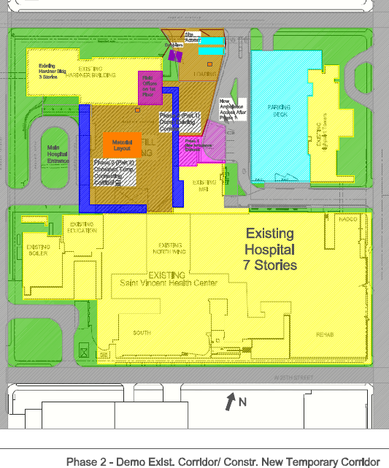
Saint Vincent Health Center
New Addition Building
Erie, PA
Tyler jaggi | CONSTRUCTION MANAGEMENT
PROJECT BACKGROUND
Saint Vincent Health Center
New Addition Building
Erie, PA
TYLER JAGGI | CONSTRUCTION MANAGEMENT
PRESENTATION OUTLINE:
  PROJECT BACKGROUND
  ANALYSIS #1: Re-Sequencing Phasing
    Background
    Case Findings
    Recommendations
  ANALYSIS #2: Precast Façade
    Design
    Structural Impact
    Schedule/Cost Impact
    Project Impact
    The Choice
  ANALYSIS #3: BIM Implementation
  ANALYSIS #4: ICRA Plan
    ICRA Matrix
    Areas of Risk
    Construction Precautions
    Mechanical Impact
  LESSONS LEARNED
  ACKNOWLEDGEMENTS
BUILDING PHASING OCCUPANCY:
  3 - Phase Project
    New Ambulance Entrance (Phase I)
      Traffic thru Existing ED Entrance off 24th St.
    Creating Temporary connecting Corridor / Demo-ing existing Connecting Corridor (Phase II)
      All ED traffic will us New ambulance Enrtance
    New In-Fill Building (Phase III - main Part)
      Pedestrian ED traffic will use South-West Temporary cooridor
      Ambulance traffic will continue using New Ambulance Entrance
WEATHER CONSIDERATIONS:
  Erie is in snow belt - 88 inches of snow per year
  Lot of rain/snow/ice/thunderstorms = rough construction scheduling
  Plan extra days for weather delays and extra snow removal costs
5

Slide 6





Saint Vincent Health Center
New Addition Building
Erie, PA
Tyler jaggi | CONSTRUCTION MANAGEMENT
INTRODUCTION OF ANALYSIS
Saint Vincent Health Center
New Addition Building
Erie, PA
TYLER JAGGI | CONSTRUCTION MANAGEMENT
PRESENTATION OUTLINE:
  PROJECT BACKGROUND
  ANALYSIS #1: Re-Sequencing Phasing
    Background
    Case Findings
    Recommendations
  ANALYSIS #2: Precast Façade
    Design
    Structural Impact
    Schedule/Cost Impact
    Project Impact
    The Choice
  ANALYSIS #3: BIM Implementation
  ANALYSIS #4: ICRA Plan
    ICRA Matrix
    Areas of Risk
    Construction Precautions
    Mechanical Impact
  LESSONS LEARNED
  ACKNOWLEDGEMENTS
ANALYSIS #1: RE-SEQUENCING PHASING
  Re-sequencing phasing and working on phases simultaneously to reduce project time
  Gen. Conditions & personal savings calculations
ANALYSIS #2: PRECAST FAÇADE
  Hand-Laid Brick Exterior Façade vs. Precast Architectural Panels
  Structural Calculations to check design of typical exterior bay
ANALYSIS #3: BIM IMPLEMENTATION
  Construction Management (EE Austin) Hasn’t used BIM before
  Plan to implement BIM on this project
ANALYSIS #4: ICRA PLAN
  ICRA Plan for Saint Vincent Project
  Mechanical Calculations to check system sizing & check CFM of outdoor air
6

Slide 7
Saint Vincent Health Center
New Addition Building
Erie, PA
Tyler jaggi | CONSTRUCTION MANAGEMENT
ANALYSIS #1: Re-Sequencing Phasing
Saint Vincent Health Center
New Addition Building
Erie, PA
TYLER JAGGI | CONSTRUCTION MANAGEMENT
PRESENTATION OUTLINE:
  PROJECT BACKGROUND
  ANALYSIS #1: Re-Sequencing Phasing
    Background
    Case Findings
    Recommendations
  ANALYSIS #2: Precast Façade
    Design
    Structural Impact
    Schedule/Cost Impact
    Project Impact
    The Choice
  ANALYSIS #3: BIM Implementation
  ANALYSIS #4: ICRA Plan
    ICRA Matrix
    Areas of Risk
    Construction Precautions
    Mechanical Impact
  LESSONS LEARNED
  ACKNOWLEDGEMENTS
BACKGROUND: PROBLEM IDENIFICATION
  3 - Phase Project
    New Ambulance Entrance (Phase I)
      Traffic thru Existing ED Entrance off 24th
    Creating Temporary connecting Corridor / Demo-ing existing Connecting Corridor (Phase II)
      All ED traffic will us New Enrtance
    New In-Fill Building (Phase III - main Part)
      Pedestrian ED traffic will use South-West Temporary cooridor
      Ambulance traffic will continue using New Ambulance Entrance
PROBLEMS with 3 – PHASES:
  potential problems with trade coordination & contractor delays
  contractors will be switching between renovation, demolishing and new construction work creates inefficiency
  Project takes longer without multi-phasing work
7

Slide 8


Saint Vincent Health Center
New Addition Building
Erie, PA
Tyler jaggi | CONSTRUCTION MANAGEMENT
ANALYSIS #1: Re-Sequencing Phasing
Saint Vincent Health Center
New Addition Building
Erie, PA
TYLER JAGGI | CONSTRUCTION MANAGEMENT
PRESENTATION OUTLINE:
  PROJECT BACKGROUND
  ANALYSIS #1: Re-Sequencing Phasing
    Background
    Case Findings
    Recommendations
  ANALYSIS #2: Precast Façade
    Design
    Structural Impact
    Schedule/Cost Impact
    Project Impact
    The Choice
  ANALYSIS #3: BIM Implementation
  ANALYSIS #4: ICRA Plan
    ICRA Matrix
    Areas of Risk
    Construction Precautions
    Mechanical Impact
  LESSONS LEARNED
  ACKNOWLEDGEMENTS
METHODOLOGY :
  Interview Construction project team for sequencing and trade coordination issues Research material availability and resource leveling to determine production capabilities
  Contact subcontractors to discuss activity durations and man-power requirements
  Re-sequence schedule to reduce schedule length but doing unrelated work simultaneously
  Evaluate trade coordination and develop sequencing diagrams for work flow
  Analyze schedule, cost and constructability
  Analyze site congestion and trade coordination improvements
  Calculate savings in general conditions and Saint Vincent’s revenue produced due to reduced schedule
RESEARCH GOAL:
  perform an in-depth re-structuring of the project schedule to reduce schedule length by working on phase 1 and 2 unrelated tasks simultaneously
8

Slide 9
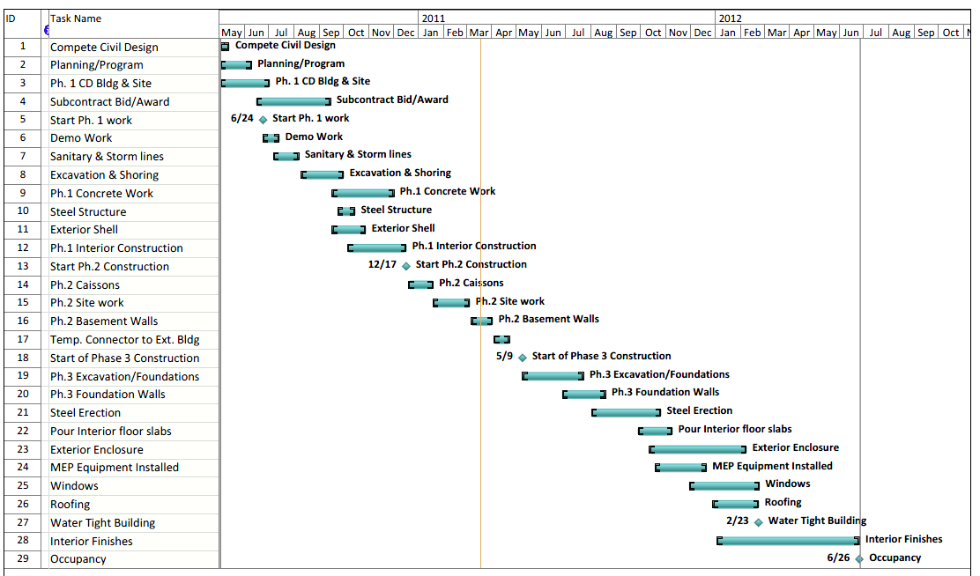
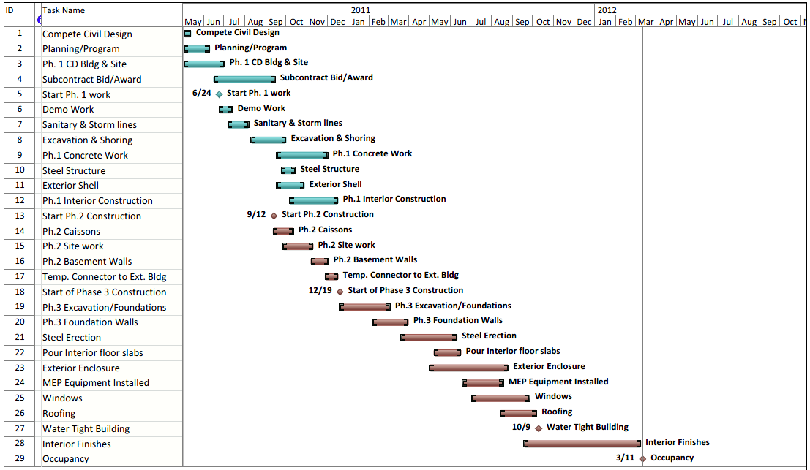
Saint Vincent Health Center
New Addition Building
Erie, PA
Tyler jaggi | CONSTRUCTION MANAGEMENT
ANALYSIS #1: Re-Sequencing Phasing
Saint Vincent Health Center
New Addition Building
Erie, PA
TYLER JAGGI | CONSTRUCTION MANAGEMENT
PRESENTATION OUTLINE:
  PROJECT BACKGROUND
  ANALYSIS #1: Re-Sequencing Phasing
    Background
    Case Findings
    Recommendations
  ANALYSIS #2: Precast Façade
    Design
    Structural Impact
    Schedule/Cost Impact
    Project Impact
    The Choice
  ANALYSIS #3: BIM Implementation
  ANALYSIS #4: ICRA Plan
    ICRA Matrix
    Areas of Risk
    Construction Precautions
    Mechanical Impact
  LESSONS LEARNED
  ACKNOWLEDGEMENTS
SCHEDULE REDUCTION:
  the project schedule can be reduced by working on phase 1 and 2 unrelated tasks simultaneously
  Start construction on the temporary corridor (Phase2) during the construction of the new emergency entrance (Phase 1)
    Start Phase II Sept. 12th compared to Dec. 17th
    Phase II site work would happen the same time as Phase I concrete work
  Saves approximately 13 weeks or 3 months in the schedule
  original occupancy date - estimated around June 26th
  the new occupancy date - could be around March 11th
  Start of Phase III could start as soon as Phase I is complete
9

Slide 10
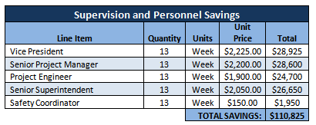
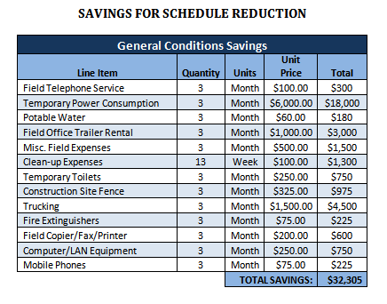

Saint Vincent Health Center
New Addition Building
Erie, PA
Tyler jaggi | CONSTRUCTION MANAGEMENT
ANALYSIS #1: Re-Sequencing Phasing
Saint Vincent Health Center
New Addition Building
Erie, PA
TYLER JAGGI | CONSTRUCTION MANAGEMENT
PRESENTATION OUTLINE:
  PROJECT BACKGROUND
  ANALYSIS #1: Re-Sequencing Phasing
    Background
    Case Findings
    Recommendations
  ANALYSIS #2: Precast Façade
    Design
    Structural Impact
    Schedule/Cost Impact
    Project Impact
    The Choice
  ANALYSIS #3: BIM Implementation
  ANALYSIS #4: ICRA Plan
    ICRA Matrix
    Areas of Risk
    Construction Precautions
    Mechanical Impact
  LESSONS LEARNED
  ACKNOWLEDGEMENTS
COST REDUCTION & SAVINGS:
  Project Finishing 13 weeks ahead of original schedule
  Personal saving due to less time needed on project
    Over $110,000 saved
  General Conditions savings from less time renting equipment and other operational cost
    Would save about $18,000 on temporary power
    3 less months of trailer rental saves $4,500
    Total General conditions saved = $32,000
SAINT VINCENT’s BENEFITS:
  Able to Open new Patient and operation rooms 13 weeks earlier = Revenue ( $ )
    Could generate several $100,000s over the 13 weeks
  Site complex could be clean and beautiful by summer
10

Slide 11



Saint Vincent Health Center
New Addition Building
Erie, PA
Tyler jaggi | CONSTRUCTION MANAGEMENT
ANALYSIS #1: Re-Sequencing Phasing
Saint Vincent Health Center
New Addition Building
Erie, PA
TYLER JAGGI | CONSTRUCTION MANAGEMENT
PRESENTATION OUTLINE:
  PROJECT BACKGROUND
  ANALYSIS #1: Re-Sequencing Phasing
    Background
    Case Findings
    Recommendations
  ANALYSIS #2: Precast Façade
    Design
    Structural Impact
    Schedule/Cost Impact
    Project Impact
    The Choice
  ANALYSIS #3: BIM Implementation
  ANALYSIS #4: ICRA Plan
    ICRA Matrix
    Areas of Risk
    Construction Precautions
    Mechanical Impact
  LESSONS LEARNED
  ACKNOWLEDGEMENTS
RECOMMENDATIONS:
  Project Finishing 13 weeks ahead of original schedule
  Personal saving due to less time needed on project
    Over $110,000 saved
  General Conditions savings from less time renting equipment and other operational cost
    Total General conditions saved = $32,000
  Total Savings approx. $140,000
  I would have recommended Saint Vincent does this on the project, but they are already past this point on the project
DRAW-BACKS:
  Need to manage more workers on site
  Decrease in quality workers
  Congestion on site will increase
  Will make entrancing the building
  harder to work around
11

Slide 12
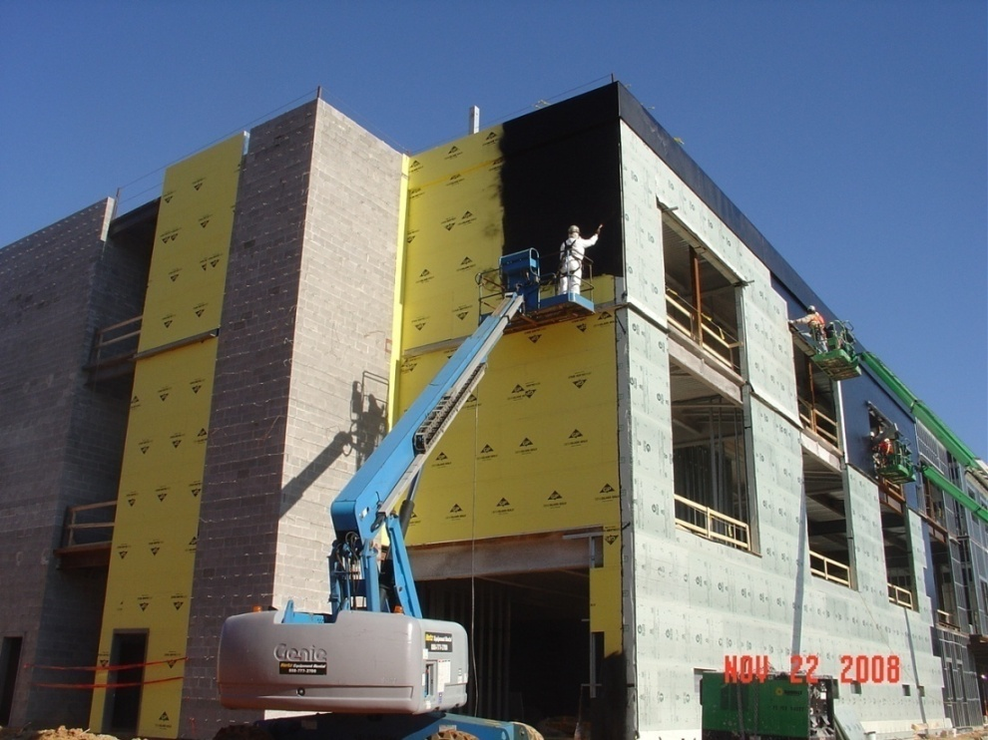

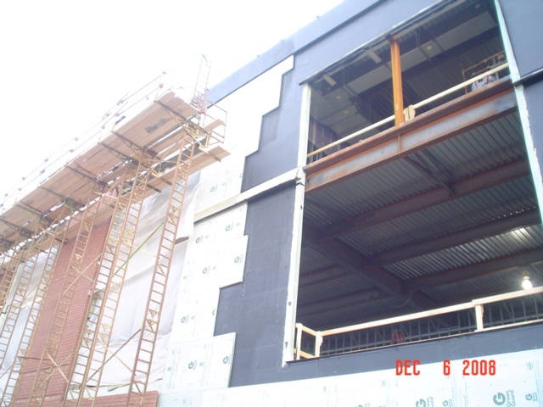
Saint Vincent Health Center
New Addition Building
Erie, PA
Tyler jaggi | CONSTRUCTION MANAGEMENT
Precast Façade vs. Hand-Laid Masonry
Saint Vincent Health Center
New Addition Building
Erie, PA
TYLER JAGGI | CONSTRUCTION MANAGEMENT
PRESENTATION OUTLINE:
  PROJECT BACKGROUND
  ANALYSIS #1: Re-Sequencing Phasing
    Background
    Case Findings
    Recommendations
  ANALYSIS #2: Precast Façade
    Design
    Structural Impact
    Schedule/Cost Impact
    Project Impact
    The Choice
  ANALYSIS #3: BIM Implementation
  ANALYSIS #4: ICRA Plan
    ICRA Matrix
    Areas of Risk
    Construction Precautions
    Mechanical Impact
  LESSONS LEARNED
  ACKNOWLEDGEMENTS
Structural Breadth
  Problem Statement:
  Hand-Laid Masonry → time and space for construction
  Problems with through wall flashing and drip edge details & application of spray-on hot fluid applied vapor barrier.
  Alternative systems may eliminate problems and ease construction
  Goal:
  Matching quality & performance
  Cost-effective
  Reduce site congestion and staging area
12

Slide 13

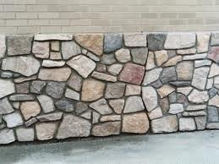
Saint Vincent Health Center
New Addition Building
Erie, PA
Tyler jaggi | CONSTRUCTION MANAGEMENT
Precast Façade vs. Hand-Laid Masonry
Saint Vincent Health Center
New Addition Building
Erie, PA
TYLER JAGGI | CONSTRUCTION MANAGEMENT
PRESENTATION OUTLINE:
  PROJECT BACKGROUND
  ANALYSIS #1: Re-Sequencing Phasing
    Background
    Case Findings
    Recommendations
  ANALYSIS #2: Precast Façade
    Design
    Structural Impact
    Schedule/Cost Impact
    Project Impact
    The Choice
  ANALYSIS #3: BIM Implementation
  ANALYSIS #4: ICRA Plan
    ICRA Matrix
    Areas of Risk
    Construction Precautions
    Mechanical Impact
  LESSONS LEARNED
  ACKNOWLEDGEMENTS
Original Façade
  Multiple façade materials
    Brick veneer
    Aluminum panels
    Stone Veneer
  Masonry is NOT load bearing
  Needs to be extremely water tight
  Brick should match existing hospital’s brick
  Drawbacks:
  Matching quality & performance
  Labor intensive
  Cost-effective
  Increases site congestion and staging area
13

Slide 14
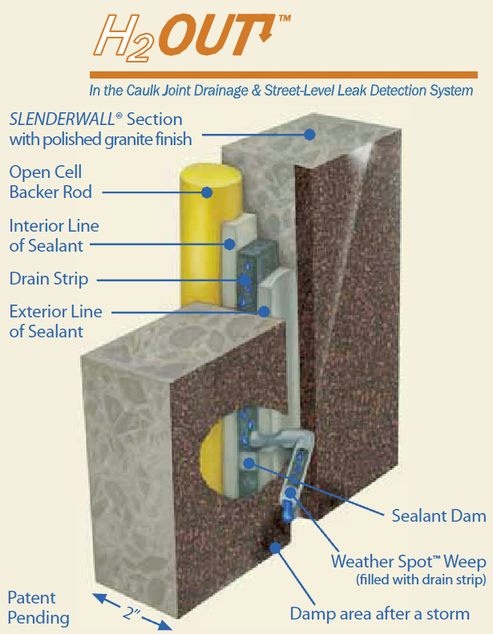
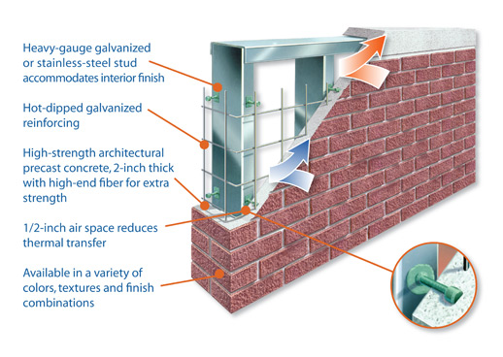
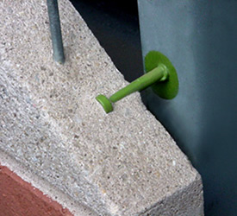
Saint Vincent Health Center
New Addition Building
Erie, PA
Tyler jaggi | CONSTRUCTION MANAGEMENT
Precast Façade vs. Hand-Laid Masonry
Saint Vincent Health Center
New Addition Building
Erie, PA
TYLER JAGGI | CONSTRUCTION MANAGEMENT
PRESENTATION OUTLINE:
  PROJECT BACKGROUND
  ANALYSIS #1: Re-Sequencing Phasing
    Background
    Case Findings
    Recommendations
  ANALYSIS #2: Precast Façade
    Design
    Structural Impact
    Schedule/Cost Impact
    Project Impact
    The Choice
  ANALYSIS #3: BIM Implementation
  ANALYSIS #4: ICRA Plan
    ICRA Matrix
    Areas of Risk
    Construction Precautions
    Mechanical Impact
  LESSONS LEARNED
  ACKNOWLEDGEMENTS
SlenderWall
Architectural Precast Concrete & Steel Stud Panel Wall System:
Exterior Surface – Thin Architectural Brick Veneer
  Veneer cast into 2 inches of reinforced precast concrete
Inside Surface – 16 gauge, 6 inch steel studs @ 2 ft on center
Connected with shear studs
SlenderWall Panel Replaces:
Brick Veneer
Spray-on Hot Fluid Applied Vapor Barrier
Exterior Sheathing
Exterior Metal Studs
14

Slide 15
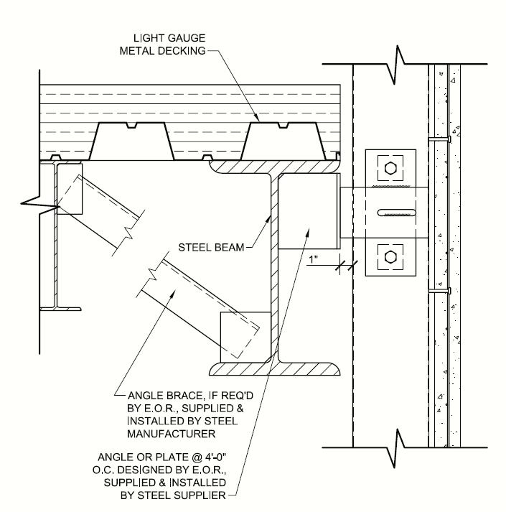
Saint Vincent Health Center
New Addition Building
Erie, PA
Tyler jaggi | CONSTRUCTION MANAGEMENT
Precast Façade vs. Hand-Laid Masonry
Saint Vincent Health Center
New Addition Building
Erie, PA
TYLER JAGGI | CONSTRUCTION MANAGEMENT
PRESENTATION OUTLINE:
  PROJECT BACKGROUND
  ANALYSIS #1: Re-Sequencing Phasing
    Background
    Case Findings
    Recommendations
  ANALYSIS #2: Precast Façade
    Design
    Structural Impact
    Schedule/Cost Impact
    Project Impact
    The Choice
  ANALYSIS #3: BIM Implementation
  ANALYSIS #4: ICRA Plan
    ICRA Matrix
    Areas of Risk
    Construction Precautions
    Mechanical Impact
  LESSONS LEARNED
  ACKNOWLEDGEMENTS
SlenderWall
Panel Sizes:
Total SF = 15,868 Sf
Most economical at 10’ x 35’ for shipping
Not recommended over 13’ x 40’
Connection to Structure:
Welded anchor or plate to exterior spandrel beams of floor above
Bolted connection as soon as panel is set by crane
15

Slide 16

Saint Vincent Health Center
New Addition Building
Erie, PA
Tyler jaggi | CONSTRUCTION MANAGEMENT
Precast Façade vs. Hand-Laid Masonry
Saint Vincent Health Center
New Addition Building
Erie, PA
TYLER JAGGI | CONSTRUCTION MANAGEMENT
PRESENTATION OUTLINE:
  PROJECT BACKGROUND
  ANALYSIS #1: Re-Sequencing Phasing
    Background
    Case Findings
    Recommendations
  ANALYSIS #2: Precast Façade
    Design
    Structural Impact
    Schedule/Cost Impact
    Project Impact
    The Choice
  ANALYSIS #3: BIM Implementation
  ANALYSIS #4: ICRA Plan
    ICRA Matrix
    Areas of Risk
    Construction Precautions
    Mechanical Impact
  LESSONS LEARNED
  ACKNOWLEDGEMENTS
Quality Comparison
Quality Comparison
Hand-Laid Brick Wall System:
  Cavity wall system
  Proven quality in construction and appearance
  Mortar joints wear over time → re-working required
  SlenderWall Precast System:
  Barrier wall system
  High Quality Architectural Class “A” Brick Veneer
  Mock-up
  100% water-tight and acts as vapor barrier
  No leaking or wearing mortar joints
  ¾” joint between panels:
    ¾” backer-rod
    ½” caulking layer
  Joints wear over time → re-working required
16

Slide 17
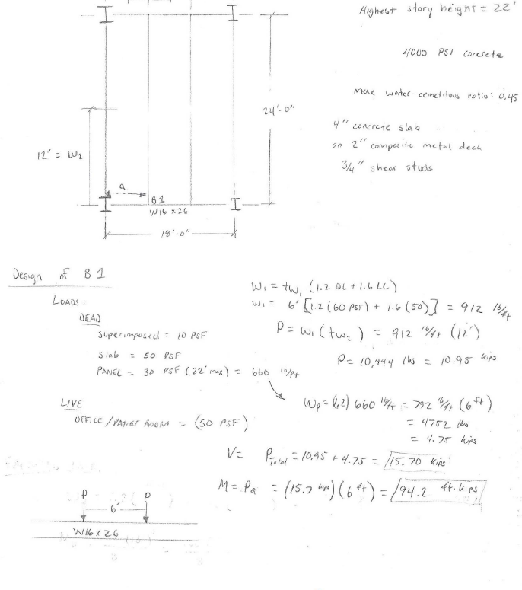
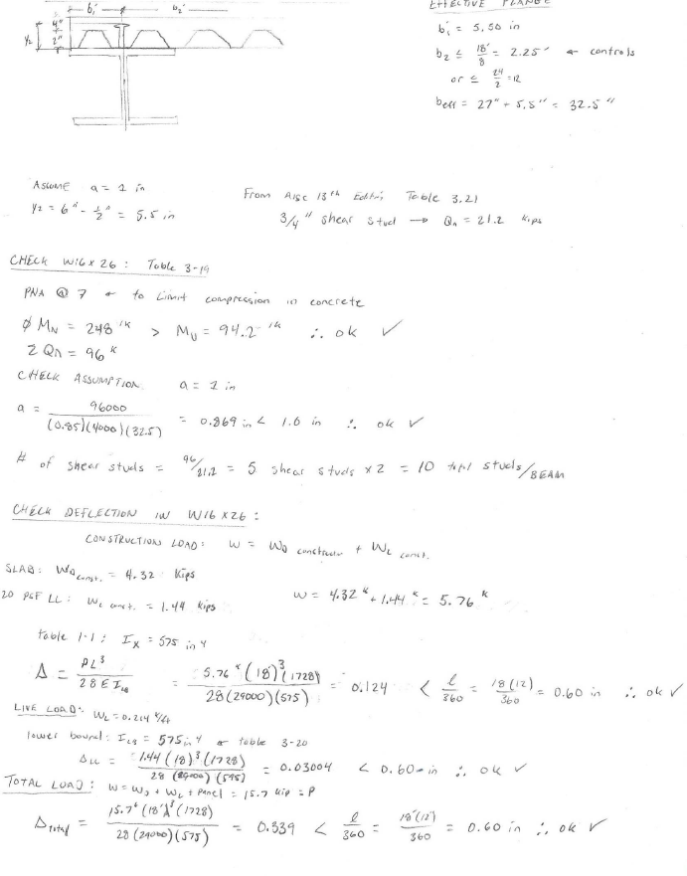
Saint Vincent Health Center
New Addition Building
Erie, PA
Tyler jaggi | CONSTRUCTION MANAGEMENT
Precast Façade vs. Hand-Laid Masonry
Saint Vincent Health Center
New Addition Building
Erie, PA
TYLER JAGGI | CONSTRUCTION MANAGEMENT
PRESENTATION OUTLINE:
  PROJECT BACKGROUND
  ANALYSIS #1: Re-Sequencing Phasing
    Background
    Case Findings
    Recommendations
  ANALYSIS #2: Precast Façade
    Design
    Structural Impact
    Schedule/Cost Impact
    Project Impact
    The Choice
  ANALYSIS #3: BIM Implementation
  ANALYSIS #4: ICRA Plan
    ICRA Matrix
    Areas of Risk
    Construction Precautions
    Mechanical Impact
  LESSONS LEARNED
  ACKNOWLEDGEMENTS
Structural Breadth
Check W 16x26 Beam for Moment:
φM_{n} = 248 ft*kips > M_{u} = 94.2 ft*kips √ OK
Check W 16x26 Beam for Deflection:
Construction Live Load:
Δ_{C-LL} = 0.124 inches < 0.6 inches √ OK
Live Load: Δ_{LL} = 0.0304 inches < 0.6 inches √ OK
Total Load: Δ_{Total} = 0.339 inches < 0.6 inches √ OK
17

Slide 18
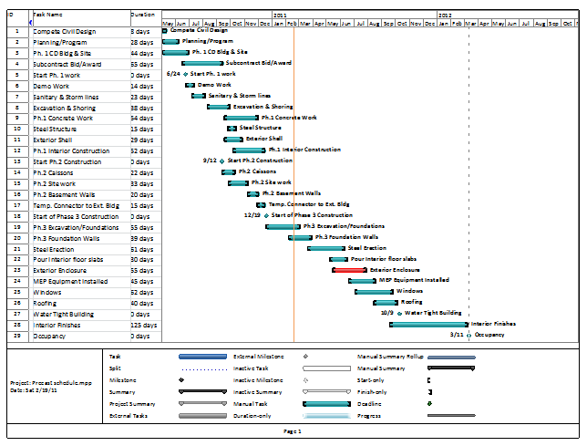
Saint Vincent Health Center
New Addition Building
Erie, PA
Tyler jaggi | CONSTRUCTION MANAGEMENT
Precast Façade vs. Hand-Laid Masonry
Saint Vincent Health Center
New Addition Building
Erie, PA
TYLER JAGGI | CONSTRUCTION MANAGEMENT
PRESENTATION OUTLINE:
  PROJECT BACKGROUND
  ANALYSIS #1: Re-Sequencing Phasing
    Background
    Case Findings
    Recommendations
  ANALYSIS #2: Precast Façade
    Design
    Structural Impact
    Schedule/Cost Impact
    Project Impact
    The Choice
  ANALYSIS #3: BIM Implementation
  ANALYSIS #4: ICRA Plan
    ICRA Matrix
    Areas of Risk
    Construction Precautions
    Mechanical Impact
  LESSONS LEARNED
  ACKNOWLEDGEMENTS
Schedule Impact
  Hand-Laid Brick – Building Enclosure Schedule:
  70 days (start to finish)
  Constructed while elevated floor slabs being poured
  Site congestion and large prepping area required
  SlenderWall – Building Enclosure Schedule:
  Fast erection time →19 minutes per panel average
  55days (start to finish)
  Allows construction to begin after superstructure is complete
  Saves 15 total days in Building Enclosure Schedule
  Reduces site congestion
  Not on critical path → allows room for unforeseen delays or issues
18

Slide 19
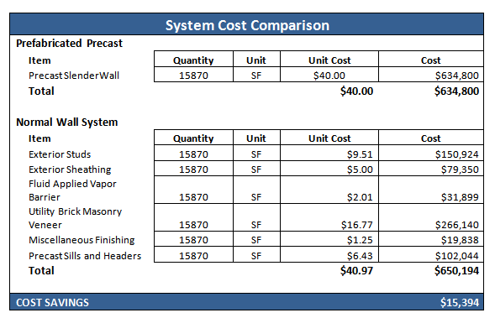
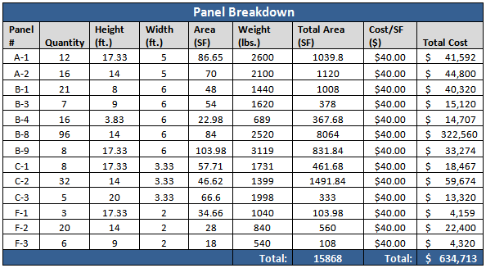
Saint Vincent Health Center
New Addition Building
Erie, PA
Tyler jaggi | CONSTRUCTION MANAGEMENT
Precast Façade vs. Hand-Laid Masonry
Saint Vincent Health Center
New Addition Building
Erie, PA
TYLER JAGGI | CONSTRUCTION MANAGEMENT
PRESENTATION OUTLINE:
  PROJECT BACKGROUND
  ANALYSIS #1: Re-Sequencing Phasing
    Background
    Case Findings
    Recommendations
  ANALYSIS #2: Precast Façade
    Design
    Structural Impact
    Schedule/Cost Impact
    Project Impact
    The Choice
  ANALYSIS #3: BIM Implementation
  ANALYSIS #4: ICRA Plan
    ICRA Matrix
    Areas of Risk
    Construction Precautions
    Mechanical Impact
  LESSONS LEARNED
  ACKNOWLEDGEMENTS
Cost Impact
  Hand-Laid Brick Wall System:
  $40.97/SF
  Includes:
    Utility brick
    Exterior sheathing
    Fluid applied vapor barrier
    Exterior studs
    Miscellaneous finishing
    Precast sills
  SlenderWall Precast System:
  $40.00/SF
19

Slide 20
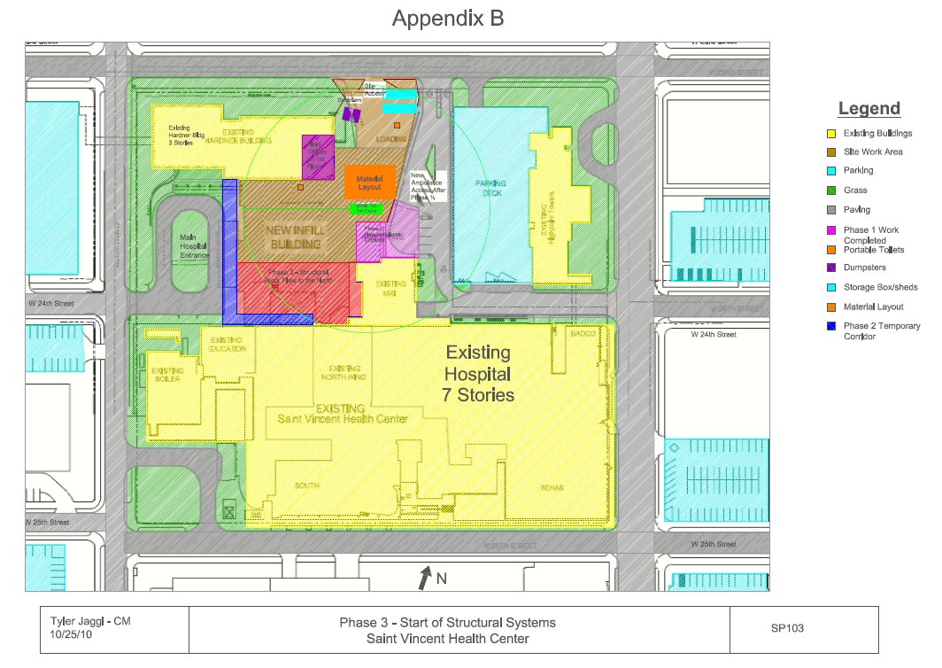
Saint Vincent Health Center
New Addition Building
Erie, PA
Tyler jaggi | CONSTRUCTION MANAGEMENT
Precast Façade vs. Hand-Laid Masonry
Saint Vincent Health Center
New Addition Building
Erie, PA
TYLER JAGGI | CONSTRUCTION MANAGEMENT
PRESENTATION OUTLINE:
  PROJECT BACKGROUND
  ANALYSIS #1: Re-Sequencing Phasing
    Background
    Case Findings
    Recommendations
  ANALYSIS #2: Precast Façade
    Design
    Structural Impact
    Schedule/Cost Impact
    Project Impact
    The Choice
  ANALYSIS #3: BIM Implementation
  ANALYSIS #4: ICRA Plan
    ICRA Matrix
    Areas of Risk
    Construction Precautions
    Mechanical Impact
  LESSONS LEARNED
  ACKNOWLEDGEMENTS
Site Congestion / Site Coordination
SITE CONGESTION:
  Reduced façade schedule allows for no trade overlap
  Concrete/steel occupy site solely
  No masonry staging areas or scaffolding
  Increased efficiency
  Only metal decking will occur during precast erection
PRECAST ERECTION SEQUENCE:
  additional phase to construction
  erection begins on East façade, works clockwise
  One delivery truck locations
  Two precast crane locations
20

Slide 21

Saint Vincent Health Center
New Addition Building
Erie, PA
Tyler jaggi | CONSTRUCTION MANAGEMENT
Precast Façade vs. Hand-Laid Masonry
Saint Vincent Health Center
New Addition Building
Erie, PA
TYLER JAGGI | CONSTRUCTION MANAGEMENT
PRESENTATION OUTLINE:
  PROJECT BACKGROUND
  ANALYSIS #1: Re-Sequencing Phasing
    Background
    Case Findings
    Recommendations
  ANALYSIS #2: Precast Façade
    Design
    Structural Impact
    Schedule/Cost Impact
    Project Impact
    The Choice
  ANALYSIS #3: BIM Implementation
  ANALYSIS #4: ICRA Plan
    ICRA Matrix
    Areas of Risk
    Construction Precautions
    Mechanical Impact
  LESSONS LEARNED
  ACKNOWLEDGEMENTS
Saint Vincent & CM’s choice
Keeping Local Jobs:
  Like to keep work for the Erie workers
  EE Austin likes using “their guys”
  Help keep money in the area
RECOMMENDATION:
  Want to keep local workers
  Lose of job for local masonry workers
  Met goal of analysis to reduce site congestion issues
  matching brick to existing hospital is important
  Ultimately would like keeping it Hand-laid by local workers
21

Slide 22
Saint Vincent Health Center
New Addition Building
Erie, PA
Tyler jaggi | CONSTRUCTION MANAGEMENT
Precast Façade vs. Hand-Laid Masonry
Saint Vincent Health Center
New Addition Building
Erie, PA
TYLER JAGGI | CONSTRUCTION MANAGEMENT
PRESENTATION OUTLINE:
  PROJECT BACKGROUND
  ANALYSIS #1: Re-Sequencing Phasing
    Background
    Case Findings
    Recommendations
  ANALYSIS #2: Precast Façade
    Design
    Structural Impact
    Schedule/Cost Impact
    Project Impact
    The Choice
  ANALYSIS #3: BIM Implementation
  ANALYSIS #4: ICRA Plan
    ICRA Matrix
    Areas of Risk
    Construction Precautions
    Mechanical Impact
  LESSONS LEARNED
  ACKNOWLEDGEMENTS
Conclusion & recommendations
FINAL CONCLUSIONS:
  Precast façade reduces schedule and cost
  Eliminates site congestion and inefficiencies
  Possible reduction of structural spandrel beams
  Minor architectural implications
RECOMMENDATIONS:
  Pursue precast façade based on constructability concerns
  Lose of job for local masonry workers
  Met goal of analysis to reduce site congestion issues
  Ultimately owner/arch. must make decision
22

Slide 23
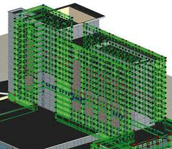
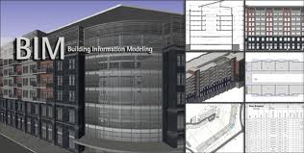
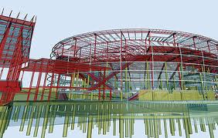
Saint Vincent Health Center
New Addition Building
Erie, PA
Tyler jaggi | CONSTRUCTION MANAGEMENT
ANALYSIS #3: BIM IMPLEMENTATION
Saint Vincent Health Center
New Addition Building
Erie, PA
TYLER JAGGI | CONSTRUCTION MANAGEMENT
PRESENTATION OUTLINE:
  PROJECT BACKGROUND
  ANALYSIS #1: Re-Sequencing Phasing
    Background
    Case Findings
    Recommendations
  ANALYSIS #2: Precast Façade
    Design
    Structural Impact
    Schedule/Cost Impact
    Project Impact
    The Choice
  ANALYSIS #3: BIM Implementation
  ANALYSIS #4: ICRA Plan
    ICRA Matrix
    Areas of Risk
    Construction Precautions
    Mechanical Impact
  LESSONS LEARNED
  ACKNOWLEDGEMENTS
Background
Background:
  BIM has many Benefits
  CM (EE Austin) has never used BIM
  MEP Engineer (Karpinski Engineering) has Experience with BIM
  Multi-Phased Projects get a lot of use out of BIM
Goal :
  Define BIM and the process needed to coordinate BIM systems in 3D
  Compare traditional 2D vs. BIM 3D & 4D
  Project specific implementation plan
  Assess final returns on investment
23

Slide 24
Saint Vincent Health Center
New Addition Building
Erie, PA
Tyler jaggi | CONSTRUCTION MANAGEMENT
ANALYSIS #3: BIM IMPLEMENTATION
Saint Vincent Health Center
New Addition Building
Erie, PA
TYLER JAGGI | CONSTRUCTION MANAGEMENT
PRESENTATION OUTLINE:
  PROJECT BACKGROUND
  ANALYSIS #1: Re-Sequencing Phasing
    Background
    Case Findings
    Recommendations
  ANALYSIS #2: Precast Façade
    Design
    Structural Impact
    Schedule/Cost Impact
    Project Impact
    The Choice
  ANALYSIS #3: BIM Implementation
  ANALYSIS #4: ICRA Plan
    ICRA Matrix
    Areas of Risk
    Construction Precautions
    Mechanical Impact
  LESSONS LEARNED
  ACKNOWLEDGEMENTS
Traditional 2D vs. 3D BIM
2D Traditional Coordination:
  Consumes large amount of time
  Generally does not identify all systems conflicts
  No clash reports are produced
  Requires multiple meetings for same areas
  Issues with MEP coordination lead to change orders and further consumption of time
  Change orders come with a cost premium to an owner causing the budget to grow
3D BIM Coordination :
  Reduces Time spent coordinating & making changes
  Can Identify most or all systems conflicts
  Can run clash detections
  speeds up change order process
  greatly improves site visualization
24

Slide 25
Saint Vincent Health Center
New Addition Building
Erie, PA
Tyler jaggi | CONSTRUCTION MANAGEMENT
ANALYSIS #3: BIM IMPLEMENTATION
Saint Vincent Health Center
New Addition Building
Erie, PA
TYLER JAGGI | CONSTRUCTION MANAGEMENT
PRESENTATION OUTLINE:
  PROJECT BACKGROUND
  ANALYSIS #1: Re-Sequencing Phasing
    Background
    Case Findings
    Recommendations
  ANALYSIS #2: Precast Façade
    Design
    Structural Impact
    Schedule/Cost Impact
    Project Impact
    The Choice
  ANALYSIS #3: BIM Implementation
  ANALYSIS #4: ICRA Plan
    ICRA Matrix
    Areas of Risk
    Construction Precautions
    Mechanical Impact
  LESSONS LEARNED
  ACKNOWLEDGEMENTS
Implementation recommendations:
  The CM EE Austin will assume lead role since they hold all sub-contracts
  Need for 3D modeling experienced workers
  Karpinski Engineering can help with problems
    Improved coordination since they run mechanical, electrical and plumbing contracts
  A good modeling software is needed, along with trained 3D modeler
Conclusion:
  New Technology provides opportunities for innovation and creativity
  Can improve the projects coordination & decrease the problems in the field
  Can run clash detections
  speeds up change order process
  I would recommend that they use BIM to help on this project and future projects
25

Slide 26
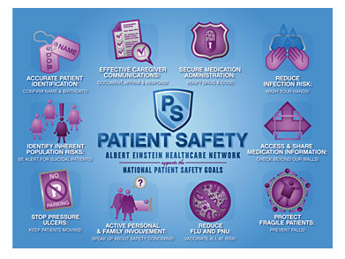

Saint Vincent Health Center
New Addition Building
Erie, PA
Tyler jaggi | CONSTRUCTION MANAGEMENT
ANALYSIS #4: ICRA PLAN
Saint Vincent Health Center
New Addition Building
Erie, PA
TYLER JAGGI | CONSTRUCTION MANAGEMENT
PRESENTATION OUTLINE:
  PROJECT BACKGROUND
  ANALYSIS #1: Re-Sequencing Phasing
    Background
    Case Findings
    Recommendations
  ANALYSIS #2: Precast Façade
    Design
    Structural Impact
    Schedule/Cost Impact
    Project Impact
    The Choice
  ANALYSIS #3: BIM Implementation
  ANALYSIS #4: ICRA Plan
    ICRA Matrix
    Areas of Risk
    Construction Precautions
    Mechanical Impact
  LESSONS LEARNED
  ACKNOWLEDGEMENTS
Problem Identification:
  Health Care Facilities have high protection requirements during construction
  Fire Hazards, Chemical exposures and air contamination are just some of the possible risks
Goal :
  Create a ICRA plan for the SVHC hospital to keep a safe and clean condition for the patients
  Identify areas of high risk and show precautionary measure that should be taking to reduce such ricks
  Mechanical Breadth was done on checking size of HVAC system and typical room calculations
  Perform sample calculations to check the CFM and the loads of typical rooms (Mech. Breadth)
26

Slide 27

Saint Vincent Health Center
New Addition Building
Erie, PA
Tyler jaggi | CONSTRUCTION MANAGEMENT
ANALYSIS #4: ICRA PLAN
Saint Vincent Health Center
New Addition Building
Erie, PA
TYLER JAGGI | CONSTRUCTION MANAGEMENT
PRESENTATION OUTLINE:
  PROJECT BACKGROUND
  ANALYSIS #1: Re-Sequencing Phasing
    Background
    Case Findings
    Recommendations
  ANALYSIS #2: Precast Façade
    Design
    Structural Impact
    Schedule/Cost Impact
    Project Impact
    The Choice
  ANALYSIS #3: BIM Implementation
  ANALYSIS #4: ICRA Plan
    ICRA Matrix
    Areas of Risk
    Construction Precautions
    Mechanical Impact
  LESSONS LEARNED
  ACKNOWLEDGEMENTS
Methodology:
  Research current ICRA typical plans
  Contact Infection control professionals
  Identify areas with highest risk
  Create diagram showing the areas with the most risk
  Developing plan to reduce and eliminate risks
  Mechanical Breadth: Check air handling system to see if it is large enough to pressurize & manage CFM for building during construction
  Analyze ICRA matrix
Background:
  Improperly designed and maintained environments pose numerous risks for patients
    Airborne Infections
    Fires
    chemical exposures
    contaminated air
27

Slide 28

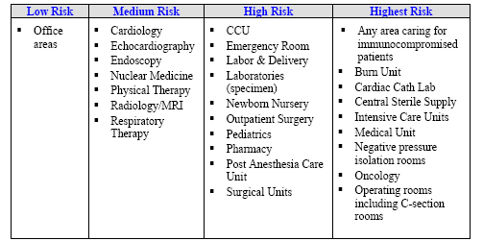
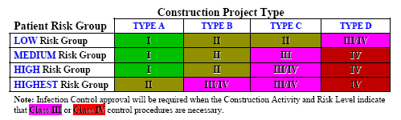
Saint Vincent Health Center
New Addition Building
Erie, PA
Tyler jaggi | CONSTRUCTION MANAGEMENT
ANALYSIS #4: ICRA PLAN
Saint Vincent Health Center
New Addition Building
Erie, PA
TYLER JAGGI | CONSTRUCTION MANAGEMENT
PRESENTATION OUTLINE:
  PROJECT BACKGROUND
  ANALYSIS #1: Re-Sequencing Phasing
    Background
    Case Findings
    Recommendations
  ANALYSIS #2: Precast Façade
    Design
    Structural Impact
    Schedule/Cost Impact
    Project Impact
    The Choice
  ANALYSIS #3: BIM Implementation
  ANALYSIS #4: ICRA Plan
    ICRA Matrix
    Areas of Risk
    Construction Precautions
    Mechanical Impact
  LESSONS LEARNED
  ACKNOWLEDGEMENTS
Infection Control Risk Assessment Matrix :
  1st step: type of construction activity
    Type D for Saint Vincent Construction
    Includes new construction or major demolition
  2nd step: identify “patient risk group”
    Corridors & stair wells are lower risk
    Emergency rooms & doctors offices are high risk
    For Saint Vincent it includes both, so High risk should be chosen
  3rd Step: class of precautions based off step 2 (high)
    Saint Vincent project is Class IV
    Gives infection control precautions for Class IV during and after construction
28

Slide 29
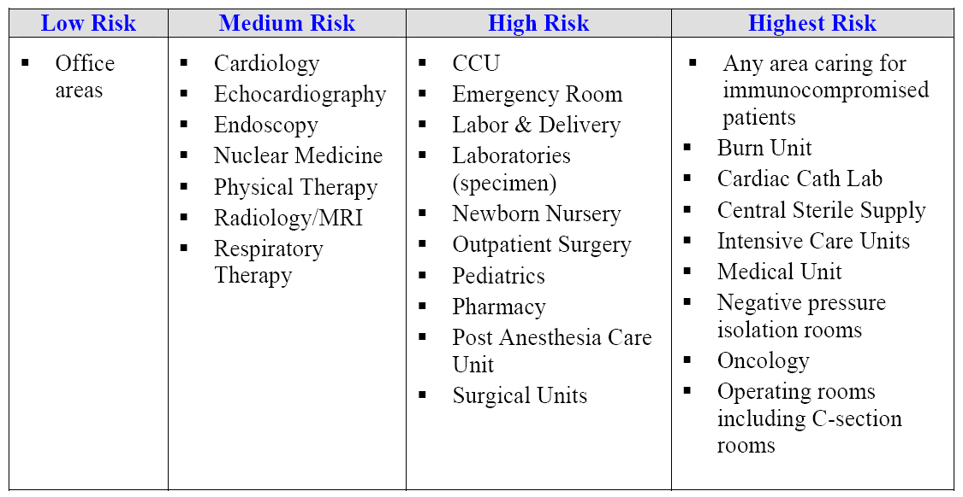
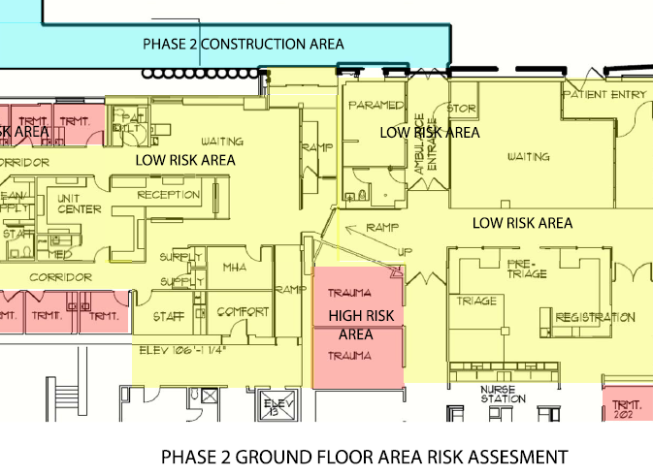
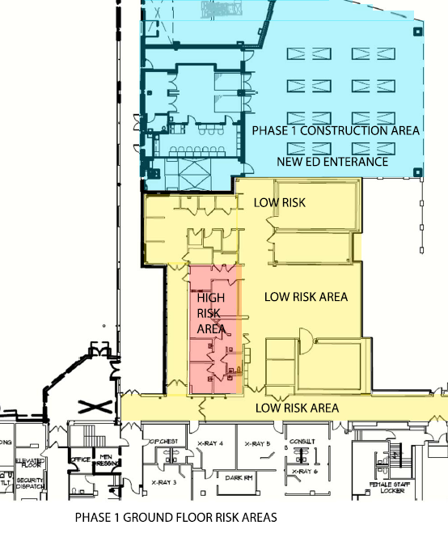
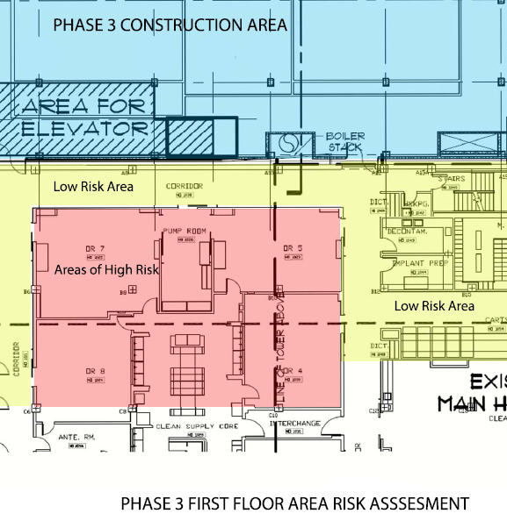
Saint Vincent Health Center
New Addition Building
Erie, PA
Tyler jaggi | CONSTRUCTION MANAGEMENT
ANALYSIS #4: ICRA PLAN
Saint Vincent Health Center
New Addition Building
Erie, PA
TYLER JAGGI | CONSTRUCTION MANAGEMENT
PRESENTATION OUTLINE:
  PROJECT BACKGROUND
  ANALYSIS #1: Re-Sequencing Phasing
    Background
    Case Findings
    Recommendations
  ANALYSIS #2: Precast Façade
    Design
    Structural Impact
    Schedule/Cost Impact
    Project Impact
    The Choice
  ANALYSIS #3: BIM Implementation
  ANALYSIS #4: ICRA Plan
    ICRA Matrix
    Areas of Risk
    Construction Precautions
    Mechanical Impact
  LESSONS LEARNED
  ACKNOWLEDGEMENTS
Areas of Risk
Areas of Risk
29

Slide 30
Saint Vincent Health Center
New Addition Building
Erie, PA
Tyler jaggi | CONSTRUCTION MANAGEMENT
ANALYSIS #4: ICRA PLAN
Saint Vincent Health Center
New Addition Building
Erie, PA
TYLER JAGGI | CONSTRUCTION MANAGEMENT
PRESENTATION OUTLINE:
  PROJECT BACKGROUND
  ANALYSIS #1: Re-Sequencing Phasing
    Background
    Case Findings
    Recommendations
  ANALYSIS #2: Precast Façade
    Design
    Structural Impact
    Schedule/Cost Impact
    Project Impact
    The Choice
  ANALYSIS #3: BIM Implementation
  ANALYSIS #4: ICRA Plan
    ICRA Matrix
    Areas of Risk
    Construction Precautions
    Mechanical Impact
  LESSONS LEARNED
  ACKNOWLEDGEMENTS
Description of the Required Infection Control Precautions for Class IV
Requirements during Construction Project:
Isolate HVAC system in area where work is being done to prevent contamination of duct system.
2. Complete all critical barriers i.e. sheetrock, plywood, plastic, to seal area from non work area or implement control cube method (cart with plastic covering and sealed connection to work site with HEPA vacuum for vacuuming prior to exit) before construction begins.
3. Maintain negative air pressure within work site utilizing HEPA equipped air filtration units.
4. Seal holes, pipes, conduits, and punctures.
5. Construct anteroom and require all personnel to pass through this room so they can be vacuumed using a HEPA vacuum cleaner before leaving work site or they can wear cloth or paper coveralls that are removed each time they leave work site.
6. All personnel entering work site are required to wear shoe covers. Shoe covers must be changed each time the worker exits the work area.
7. Do not remove barriers from work area until completed project is inspected by the owner’s Safety Department and Infection Control Department and thoroughly cleaned
30

Slide 31
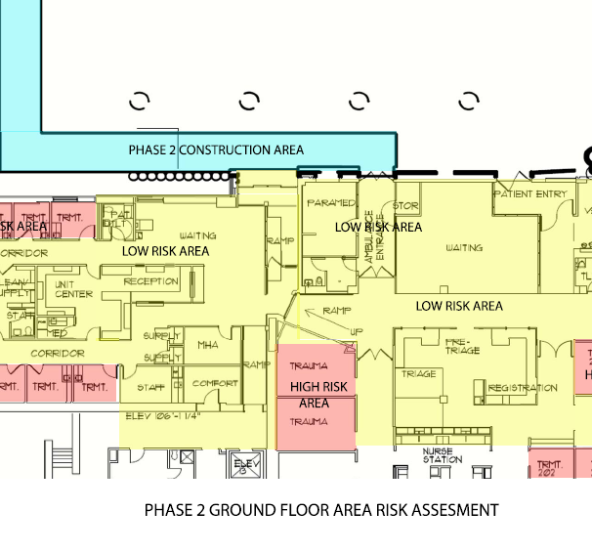
Saint Vincent Health Center
New Addition Building
Erie, PA
Tyler jaggi | CONSTRUCTION MANAGEMENT
ANALYSIS #4: ICRA PLAN
Saint Vincent Health Center
New Addition Building
Erie, PA
TYLER JAGGI | CONSTRUCTION MANAGEMENT
PRESENTATION OUTLINE:
  PROJECT BACKGROUND
  ANALYSIS #1: Re-Sequencing Phasing
    Background
    Case Findings
    Recommendations
  ANALYSIS #2: Precast Façade
    Design
    Structural Impact
    Schedule/Cost Impact
    Project Impact
    The Choice
  ANALYSIS #3: BIM Implementation
  ANALYSIS #4: ICRA Plan
    ICRA Matrix
    Areas of Risk
    Construction Precautions
    Mechanical Impact
  LESSONS LEARNED
  ACKNOWLEDGEMENTS
Description of the Required Infection Control Precautions for Class IV
Requirements upon Completion of Project:
Remove barrier material carefully to minimize spreading of dirt and debris associated with construction.
2. Contain construction waste before transport in tightly covered containers.
3. Cover transport receptacles or carts. Tape covering unless solid lid
4. Vacuum work area with HEPA filtered vacuums.
5. Wet mop area with disinfectant.
6. Remove isolation of HVAC system in areas where work is being performed.
31

Slide 32
Saint Vincent Health Center
New Addition Building
Erie, PA
Tyler jaggi | CONSTRUCTION MANAGEMENT
ANALYSIS #4: ICRA PLAN
Saint Vincent Health Center
New Addition Building
Erie, PA
TYLER JAGGI | CONSTRUCTION MANAGEMENT
PRESENTATION OUTLINE:
  PROJECT BACKGROUND
  ANALYSIS #1: Re-Sequencing Phasing
    Background
    Case Findings
    Recommendations
  ANALYSIS #2: Precast Façade
    Design
    Structural Impact
    Schedule/Cost Impact
    Project Impact
    The Choice
  ANALYSIS #3: BIM Implementation
  ANALYSIS #4: ICRA Plan
    ICRA Matrix
    Areas of Risk
    Construction Precautions
    Mechanical Impact
  LESSONS LEARNED
  ACKNOWLEDGEMENTS
From ASHRAE 2007 Handbook, the minimum total air changes per hour are between 6 and 20 is the max. To simplify and assume worst case scenario, for the calculation I will make all rooms need 20 air changes. The calculations for this are as followed:
(2.032 million ft³)/(60 min/20) = 677,400 Total CFM for ground floor
Checking % of outside air for system:
169,400 outside CFM / 667,400 total CFM = 25.4% outside air
To check typical CFM/sf should be around
[1500 tons x 12,000 btu/ton ] / [1.08 x 3(677,400)] = 8.2 degrees (max delta T for cooling)
Mechanical Breadth
(Not Covered in Presentation)
Findings:
  HVAC system is large enough to handle all construction and post-construction needs & loads
Part of Mechanical Calculations:
Calculations for the ventilation sensible and latent load for a total hospital floor:
Total volume for ground floor = 145,152 ft² x 14 ft story height = 2.032 Million ft³
From ASHRAE 2007 Handbook, the minimum air changes of outside air per hour are between 2 and 5. To simplify and assume worst case scenario, for the calculation I will make all rooms need 5 minimum air changes. The calculations for this are as followed:
(2.032 million ft³)/(60 min/5) = 169,400 Total CFM of outside air for ground floor
32

Slide 33

Saint Vincent Health Center
New Addition Building
Erie, PA
Tyler jaggi | CONSTRUCTION MANAGEMENT
SUMMARY OF CONCLUSIONS
Saint Vincent Health Center
New Addition Building
Erie, PA
TYLER JAGGI | CONSTRUCTION MANAGEMENT
PRESENTATION OUTLINE:
  PROJECT BACKGROUND
  ANALYSIS #1: Re-Sequencing Phasing
    Background
    Case Findings
    Recommendations
  ANALYSIS #2: Precast Façade
    Design
    Structural Impact
    Schedule/Cost Impact
    Project Impact
    The Choice
  ANALYSIS #3: BIM Implementation
  ANALYSIS #4: ICRA Plan
    ICRA Matrix
    Areas of Risk
    Construction Precautions
    Mechanical Impact
  LESSONS LEARNED
  ACKNOWLEDGEMENTS
ANALYSIS #1: RE-SEQUENCING PHASING
  Project Finishing 13 weeks ahead of original schedule
  Personal saving due to less time needed on project
    Over $110,000 saved
  General Conditions savings from less time renting equipment and other operational cost
    Total General conditions saved = $32,000
  Total Savings approx. $140,000
ANALYSIS #2: PRECAST FAÇADE
  Precast façade reduces schedule and cost
  Eliminates site congestion and inefficiencies
  Possible reduction of structural spandrel beams
  Precast saves $15,000 & 15 days off schedule
  Precast would case local workers to lose work
ANALYSIS #3: BIM IMPLEMENTATION
  Saint Vincent would benefit by implementing BIM
  BIM has many advantages
    Improved coordination
    3D visualization
    Clash detection
ANALYSIS #4: ICRA PLAN
  ICRA Plan for Saint Vincent Project
  Saint Vincent construction type is D
  The hospital has both High & lower areas of risk
    Need to meet requirements for higher risk
  Saint Vincent project is Class IV
  Mechanical Calculations check that system sizing enough
33

Slide 34

Saint Vincent Health Center
New Addition Building
Erie, PA
Tyler jaggi | CONSTRUCTION MANAGEMENT
ACKNOWLEDGEMENTS
Saint Vincent Health Center
New Addition Building
Erie, PA
TYLER JAGGI | CONSTRUCTION MANAGEMENT
PRESENTATION OUTLINE:
  PROJECT BACKGROUND
  ANALYSIS #1: Re-Sequencing Phasing
    Background
    Case Findings
    Recommendations
  ANALYSIS #2: Precast Façade
    Design
    Structural Impact
    Schedule/Cost Impact
    Project Impact
    The Choice
  ANALYSIS #3: BIM Implementation
  ANALYSIS #4: ICRA Plan
    ICRA Matrix
    Areas of Risk
    Construction Precautions
    Mechanical Impact
  LESSONS LEARNED
  ACKNOWLEDGEMENTS
Academic Acknowledgments:
Penn State AE Faculty
Dr. David Riley – CM Advisor
Special Thanks To:
Saint Vincent Health Center
EE Austin’s Project Team
Saint Vincent Project Team
PACE Industry Members
My Family and Friends
Industry Acknowledgments:
34

Slide 36
Saint Vincent Health Center
New Addition Building
Erie, PA
Tyler jaggi | CONSTRUCTION MANAGEMENT
Precast Façade vs. Hand-Laid Masonry
Saint Vincent Health Center
New Addition Building
Erie, PA
TYLER JAGGI | CONSTRUCTION MANAGEMENT
PRESENTATION OUTLINE:
  PROJECT BACKGROUND
  ANALYSIS #1: Re-Sequencing Phasing
    Background
    Case Findings
    Recommendations
  ANALYSIS #2: Precast Façade
    Design
    Structural Impact
    Schedule/Cost Impact
    Project Impact
    The Choice
  ANALYSIS #3: BIM Implementation
  ANALYSIS #4: ICRA Plan
    ICRA Matrix
    Areas of Risk
    Construction Precautions
    Mechanical Impact
  LESSONS LEARNED
  ACKNOWLEDGEMENTS
Structural Breadth
Check W 16x26 Beam for Moment:
φM_{n} = 248 ft*kips > M_{u} = 94.2 ft*kips √ OK
Check W 16x26 Beam for Deflection:
Construction Live Load:
Δ_{C-LL} = 0.124 inches < 0.6 inches √ OK
Live Load: Δ_{LL} = 0.0304 inches < 0.6 inches √ OK
Total Load: Δ_{Total} = 0.339 inches < 0.6 inches √ OK
36

Slide 37
Saint Vincent Health Center
New Addition Building
Erie, PA
Tyler jaggi | CONSTRUCTION MANAGEMENT
ANALYSIS #4: ICRA PLAN
Saint Vincent Health Center
New Addition Building
Erie, PA
TYLER JAGGI | CONSTRUCTION MANAGEMENT
PRESENTATION OUTLINE:
  PROJECT BACKGROUND
  ANALYSIS #1: Re-Sequencing Phasing
    Background
    Case Findings
    Recommendations
  ANALYSIS #2: Precast Façade
    Design
    Structural Impact
    Schedule/Cost Impact
    Project Impact
    The Choice
  ANALYSIS #3: BIM Implementation
  ANALYSIS #4: ICRA Plan
    ICRA Matrix
    Areas of Risk
    Construction Precautions
    Mechanical Impact
  LESSONS LEARNED
  ACKNOWLEDGEMENTS
From ASHRAE 2007 Handbook, the minimum total air changes per hour are between 6 and 20 is the max. To simplify and assume worst case scenario, for the calculation I will make all rooms need 20 air changes. The calculations for this are as followed:
(2.032 million ft³)/(60 min/20) = 677,400 Total CFM for ground floor
Checking % of outside air for system:
169,400 outside CFM / 667,400 total CFM = 25.4% outside air
To check typical CFM/sf should be around
[1500 tons x 12,000 btu/ton ] / [1.08 x 3(677,400)] = 8.2 degrees (max delta T for cooling)
Mechanical Breadth
(Not Covered in Presentation)
Findings:
  HVAC system is large enough to handle all construction and post-construction needs & loads
Part of Mechanical Calculations:
Calculations for the ventilation sensible and latent load for a total hospital floor:
Total volume for ground floor = 145,152 ft² x 14 ft story height = 2.032 Million ft³
From ASHRAE 2007 Handbook, the minimum air changes of outside air per hour are between 2 and 5. To simplify and assume worst case scenario, for the calculation I will make all rooms need 5 minimum air changes. The calculations for this are as followed:
(2.032 million ft³)/(60 min/5) = 169,400 Total CFM of outside air for ground floor
37

Slide 38
Saint Vincent Health Center
New Addition Building
Erie, PA
Tyler jaggi | CONSTRUCTION MANAGEMENT
ANALYSIS #4: ICRA PLAN
Saint Vincent Health Center
New Addition Building
Erie, PA
TYLER JAGGI | CONSTRUCTION MANAGEMENT
PRESENTATION OUTLINE:
  PROJECT BACKGROUND
  ANALYSIS #1: Re-Sequencing Phasing
    Background
    Case Findings
    Recommendations
  ANALYSIS #2: Precast Façade
    Design
    Structural Impact
    Schedule/Cost Impact
    Project Impact
    The Choice
  ANALYSIS #3: BIM Implementation
  ANALYSIS #4: ICRA Plan
    ICRA Matrix
    Areas of Risk
    Construction Precautions
    Mechanical Impact
  LESSONS LEARNED
  ACKNOWLEDGEMENTS
Areas of Risk
Areas of Risk
38

Slide 39
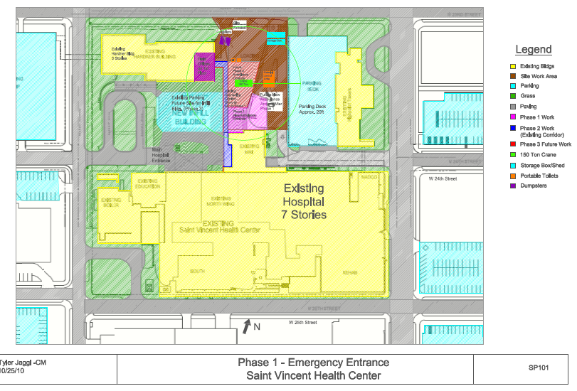
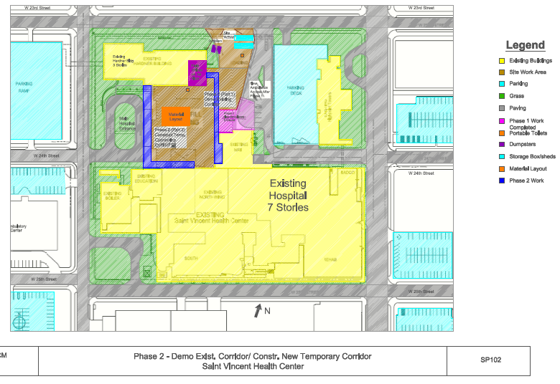
Saint Vincent Health Center
New Addition Building
Erie, PA
Tyler jaggi | CONSTRUCTION MANAGEMENT
SITE PLANS
Saint Vincent Health Center
New Addition Building
Erie, PA
TYLER JAGGI | CONSTRUCTION MANAGEMENT
PRESENTATION OUTLINE:
  PROJECT BACKGROUND
  ANALYSIS #1: Re-Sequencing Phasing
    Background
    Case Findings
    Recommendations
  ANALYSIS #2: Precast Façade
    Design
    Structural Impact
    Schedule/Cost Impact
    Project Impact
    The Choice
  ANALYSIS #3: BIM Implementation
  ANALYSIS #4: ICRA Plan
    ICRA Matrix
    Areas of Risk
    Construction Precautions
    Mechanical Impact
  LESSONS LEARNED
  ACKNOWLEDGEMENTS
39

Slide 40
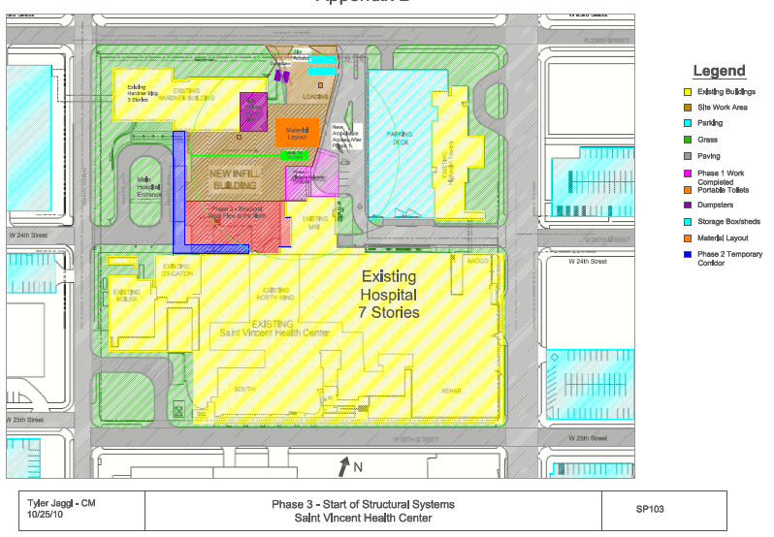
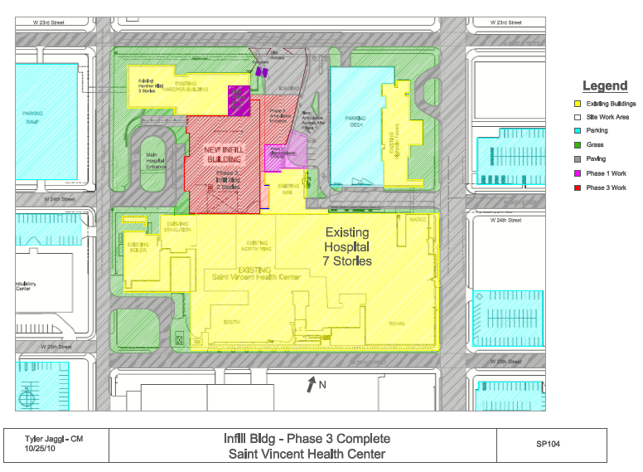
Saint Vincent Health Center
New Addition Building
Erie, PA
Tyler jaggi | CONSTRUCTION MANAGEMENT
SITE PLANS
Saint Vincent Health Center
New Addition Building
Erie, PA
TYLER JAGGI | CONSTRUCTION MANAGEMENT
PRESENTATION OUTLINE:
  PROJECT BACKGROUND
  ANALYSIS #1: Re-Sequencing Phasing
    Background
    Case Findings
    Recommendations
  ANALYSIS #2: Precast Façade
    Design
    Structural Impact
    Schedule/Cost Impact
    Project Impact
    The Choice
  ANALYSIS #3: BIM Implementation
  ANALYSIS #4: ICRA Plan
    ICRA Matrix
    Areas of Risk
    Construction Precautions
    Mechanical Impact
  LESSONS LEARNED
  ACKNOWLEDGEMENTS
40

